Slide 1
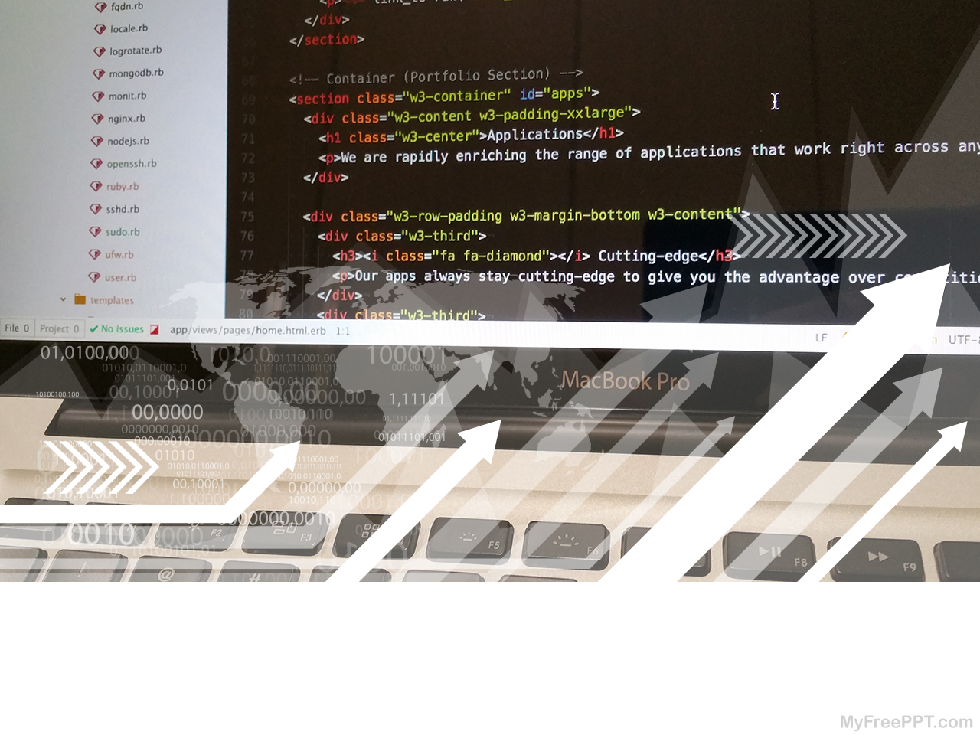
Mukono Web Project Week 11

Slide 2
Objective
Re-do/Complete Classes page
Add bios, and pictures (if available) - Sowedi
Finish about page, with new pictures, and bios. – Farouk, Ammon, Graham
Add relevant school information on all pages
Work on navbar. Site can be used on computers and tablets, but not phones.
Re-do homepage (landing page) – Anold
Project checklist:
  Mukono Website project plan - Google Docs

Slide 3
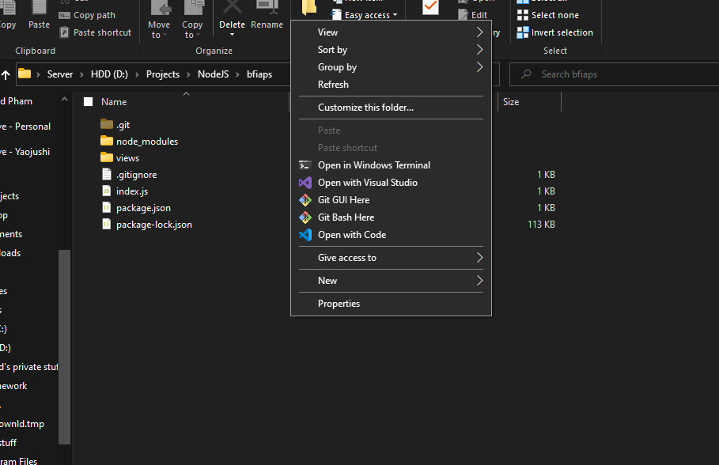

Remember
git pull
code .
Type into Windows terminal

Slide 4
A word on Bootstrap classes
Alter layout
Change background image/color
Change font
Change text color
To use, place in <div class=“classname”></div>
Anything between those tags will have their look changed accordingly.

Slide 5
<center> vs .justify-content-center
One centers everything, whilst the other centers only outer content
<center> tag is an html tag
.justify-content-center is a Bootstrap class

Slide 6
About page structure
Upload pictures to Cloudinary & paste links into codes – Sowedi (He will get his own laptop, and image files will be transferred from Kasifa’s phone to laptop)
Type up Name and bios (I was told by Graham that we have them completed) – Ammon and Farouk (use PC)
Add row of cards below existing About page content – Farouk and Graham
.row class creates new row
.col (short for “column” creates new column)

Slide 7
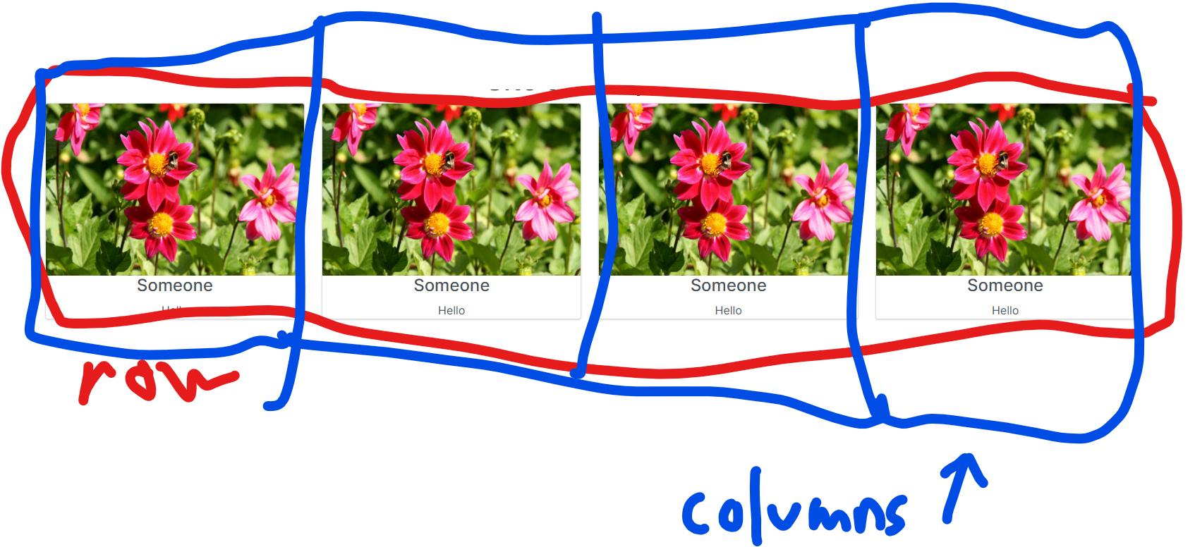
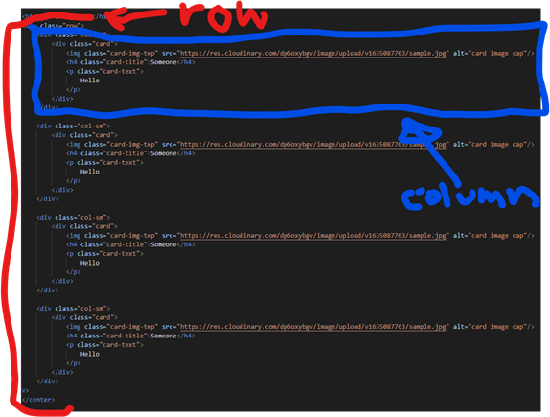
Photo example

Slide 8
Classes page structure
Look at the “Meet the staff” page for reference
I’ve re-worked the layout after light research
We’ve spent weeks trying to do this without success.
Wrap everything in <div class=“justify-content-center>
I’ve done the first card as an example to help you
Steps:
  1. Replace <center> with <div class=“d-flex justify-content-center> and </center> with </div> in file “classes.handlebars” - Ammon
  2. Follow template of first card. Farouk and Sowedi will take turns/help each other tweaking the cards so it’ll match the first example card.
  3. Once webpage structure is completed, everyone will consult Kasifa to decide how to type describe

Slide 9
Navbar
I’m currently having trouble on this particular one.
Phone screens are too small to display full navbar.
https://bootstrap-menu.com/_bootstrap4/detail-offcanvas-collapse.html
Demo - Bootstrap Navbar collapse to off canvas. html code example (bootstrap-menu.com)

Slide 10
Donation page
Research on different donation pages
Use PayPal, Venmo, Authorize.net, etc. for credit card payments
Bitcoin wallet for cryptocurrency payments
After this, the site is pretty much done
“Enroll” page isn’t priority, since it’s likely the least used feature

Slide 11
Afterwards
School logo
We can use databases such as SQL or MongoDB to store data to avoid repeating code.
Database can also be used for enroll page
We could also add a News page so donors will know what happens on campus
Look into different cloud hosting options (Heroku)
Purchase domain name and deploy to cloud server.
I may be able to deliver a real JavaScript lesson.
Notes:
We store all our media files to reduce server footprint. Heroku is a free web hosting service, and we are given very little storage, so we must minimize our footprint to just code. This is why we keep all our media files on cloudinary.

Slide 12
Good luck!
You can refer to these slides, the Internet, me, Graham, and each other.

